Slide 1
Unit test

Slide 2
It’s a situational thing – the team decides what makes sense to be a unit for purposes of their understanding of the system and its testing
Martin fowler
https://martinfowler.com/bliki/UnitTest.html

Slide 3


Slide 4
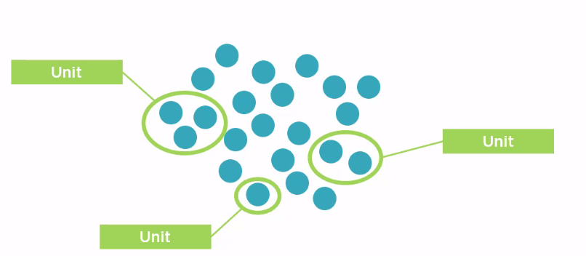

Slide 5
 | NUnit Test | xUnit Test | MS TEST 2
Class | [TestFixture] | No | [TestClass]
Single Test Case | [Test] | [Fact] | [TestMethod]
Multi-Data | [TestCase] | [Theory] | [DataTestMethod]
 |  | [InlineData] | [DataRow]
Repeat Initialization for each Test | [SetUp] | Ctor, IDisposable | [TestInitialize]
 | [TearDown] |  | [TestCleanup]
One Time initialization for all tests in one class. | [OneTimeSetUp] | [MemberData] | [ClassInitialize]
 | [OneTimeTearDown] | Or | [ClassCleanup]
 |  | [ClassData]
 |  | Method Member (may Property Member)
One Time initialization for all tests in one assembly | Dedicated class with [SetUpFixture] + [OneTimeSetUp] [OneTimeTearDown] | [MemberData] Or [ClassData] Property Member | [TestClass] + [AssemblyInitialize] [AssemblyCleanup]

Slide 6
Mocking
Replacing actual dependency

Slide 7
Why Mock?
Reduced test complexity
Improved test execution speed
Support parallel development streams
Real dependency not yet available
Another team
Improve test predictability
Reduce testing costs

Slide 8
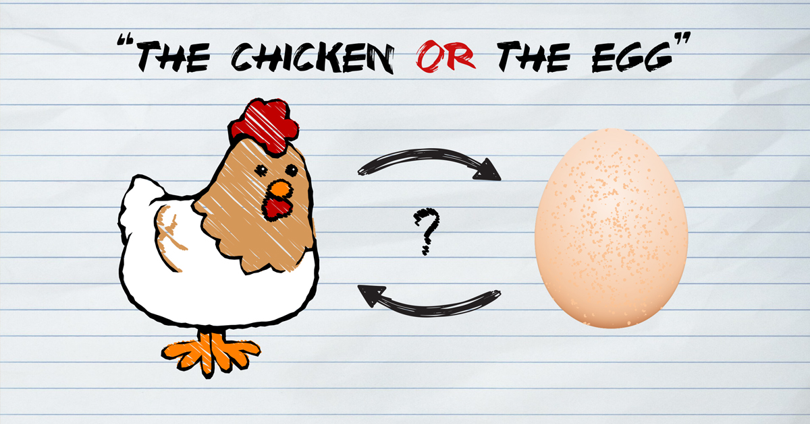
Chicken-egg problem in software development

Slide 9
Test first or code first?
It’s clean code that matters
TDD provides opportunity to create a masterpiece that proactively unbreakable and reduce time to market.

Slide 10
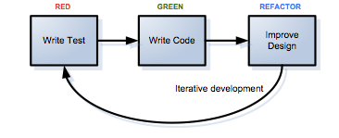
TDD is easier than I thought

